Slide 1
NEO4J CYPHER TUTORIAL WITH PYTHON
Load Json Data From Multiple Url Using Cypher ,Apoc & Python
Tutorial 90

Slide 2
Sample urls
http://dummy.restapiexample.com/api/v1/employees
https://api.github.com/users/hadley/orgs
https://api.github.com/repos/hadley/ggplot2/commits

Slide 3
Use case
How To Load Json Data From Multiple Url Using Cypher ,apoc procedure & python

Slide 4
Pre-requisites
apoc.import.file.enabled=true
apoc.import.file.use_neo4j_config=false

Slide 5
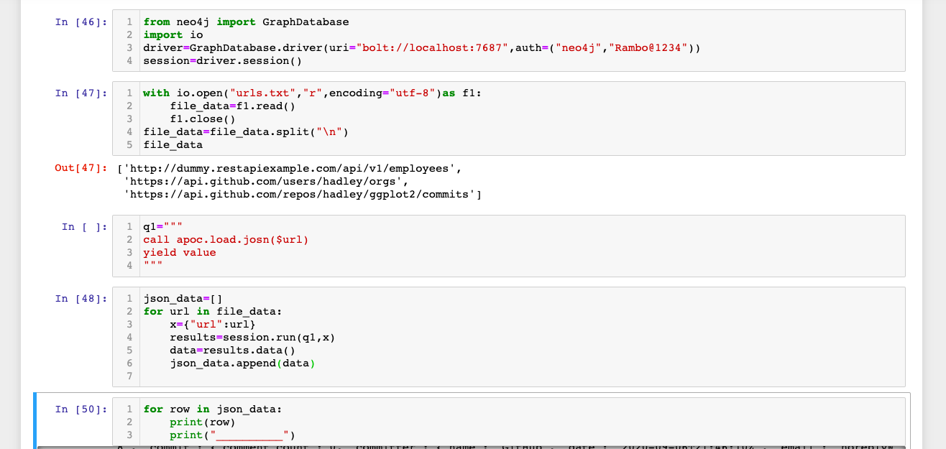
Load json data from url using apoc procedures
Code written in neo4j browser

Slide 6
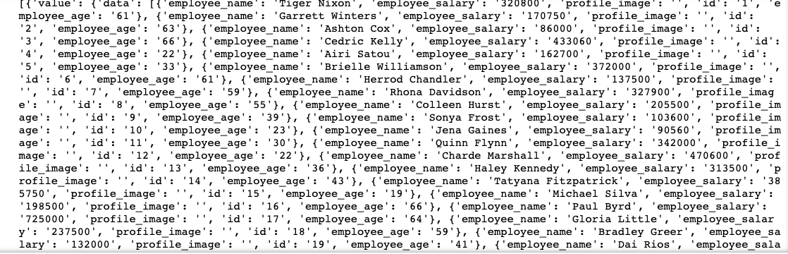
output
From neo4j browser

Slide 7
Load json data from url using apoc procedures
Code written in python ide

Slide 8
output
From python ide

